Slide 1
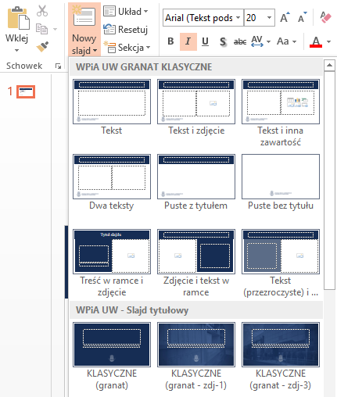
Template Guide
As part of the template, you can use two types of templates – classic (with the Ius suum cuique logo) and modern (with the logo of WPiA UW). Each template has three color versions to choose from. You can find them in the "New Slide" section.
In the classic pattern, the fonts Georgia (titles) and Arial (content) were used. The modern pattern uses the fonts Gadugi (titles) and Arial (content). Please keep them while editing the presentation.

